Slide 1

Classification of Histopathological Breast cancer images using Deep Learning
Rishab Kumar
1701EE39
Under the guidance of Dr. M H Kolekar

Slide 2
Introduction
Histopathological images
Mammogram images
Extracted feature based data
Ultrasounds
MRI images
Certain types of breast cancer images
Histopathological images from ICIAR2018 dataset

Slide 3
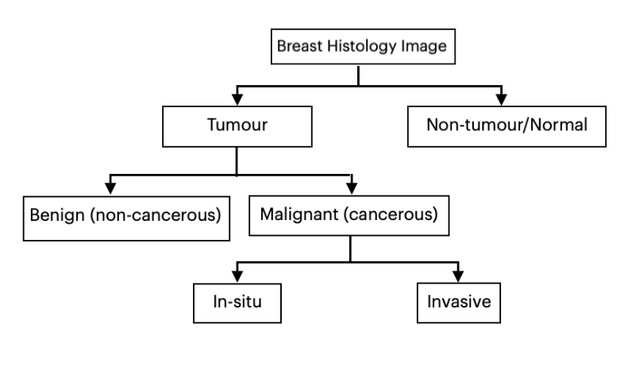
Classification of breast histology images

Slide 4
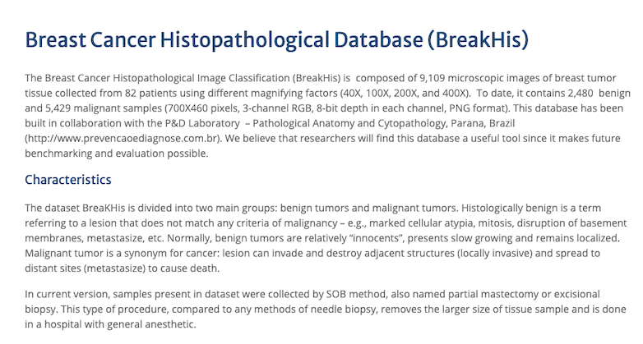
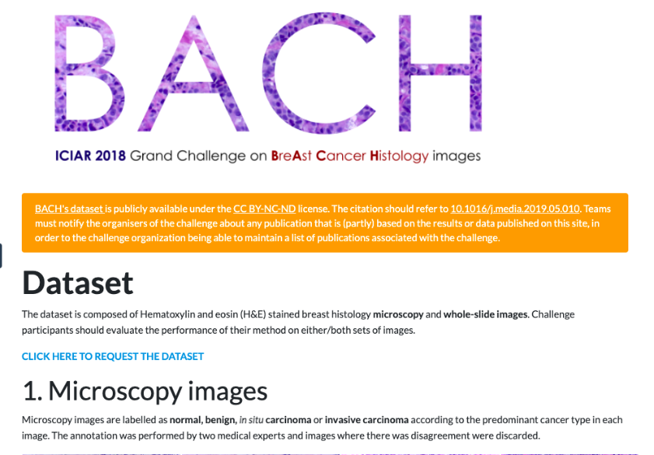
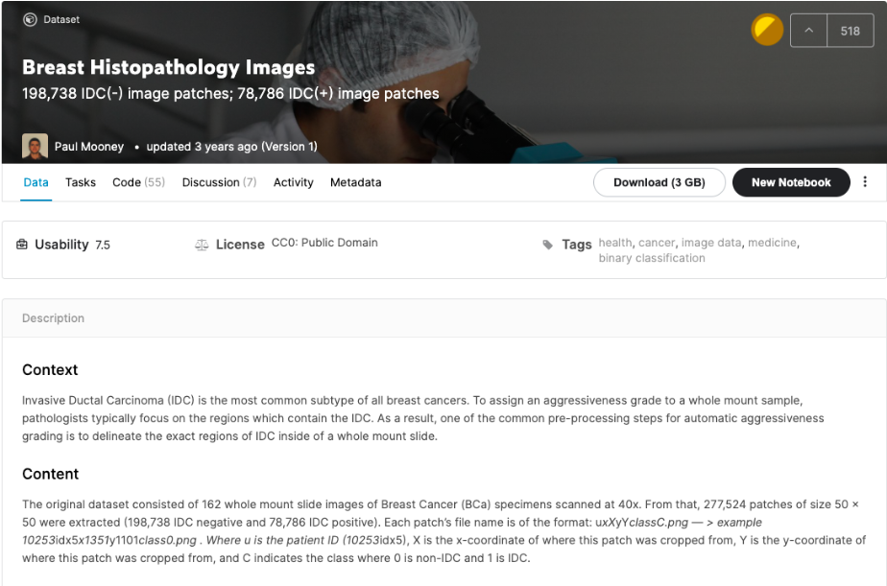
Datasets
Three standard datasets were chosen for training and testing purposes
Breakhis Dataset
ICIAR2018 Dataset
Kaggle Breast Histology Images Dataset
Breakhis ICIAR2018 Kaggle BHI

Slide 5
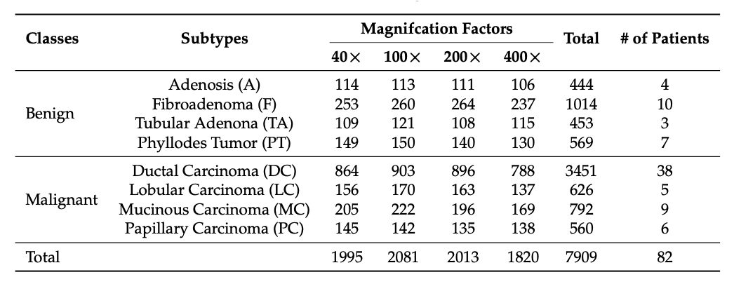
Breakhis dataset

Slide 6
Methodology
Used 5 top performing classification models in parallel
Chance that an important feature will be missed is very less if we are using 5 independent classification architectures in concatenation
DenseNet201: consists of 201 layers
ResNet152: consists of 152 layers
VGG19: consists of 19 layers
Xception: consists of 71 layers
Inception_v3: consists of 48 layers

Slide 7
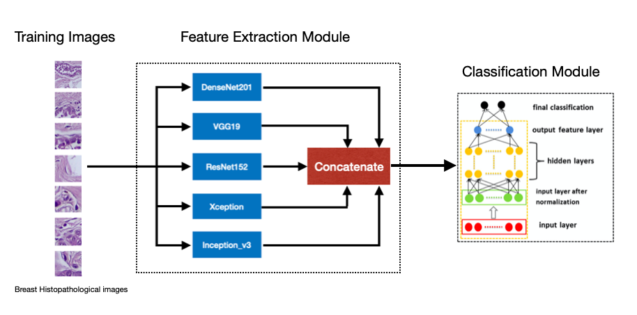
Model architecture

Slide 8
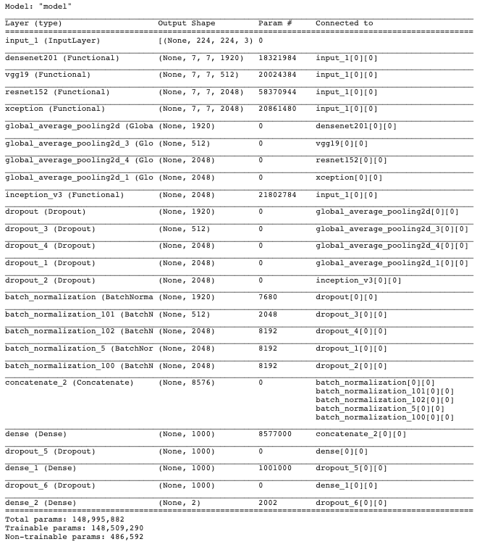
Model
Summary

Slide 9
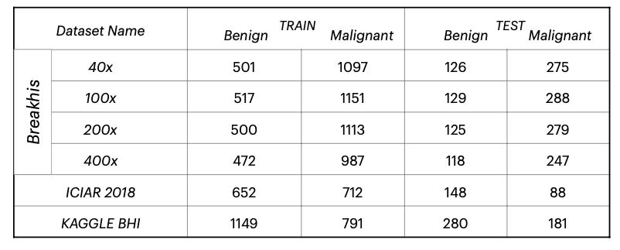
Training
80% training
20% testing
Batch size : 16
Epochs: 100

Slide 10
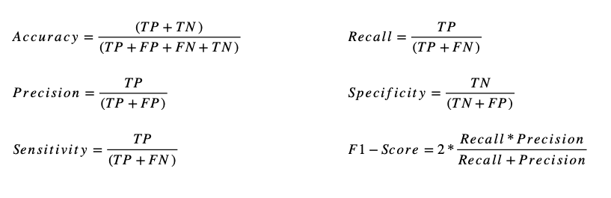
Performance measures
Positive is taken as MALIGNANT and negative is taken as BENIGN

Slide 11
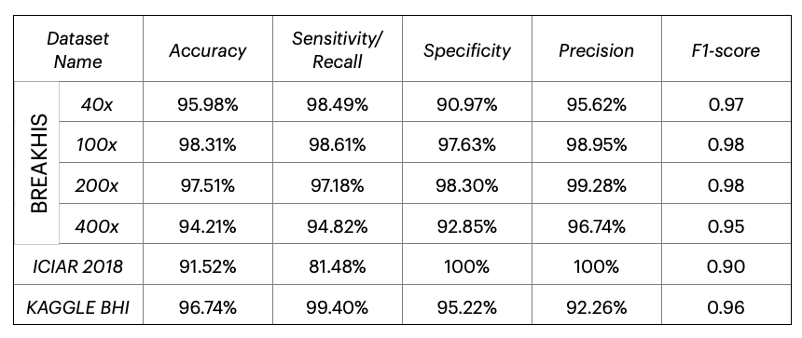
RESULT

Slide 12
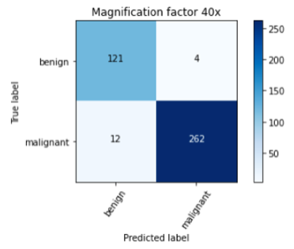
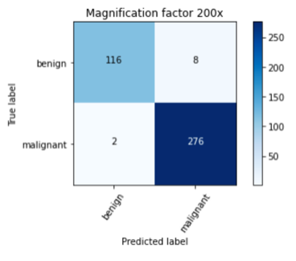
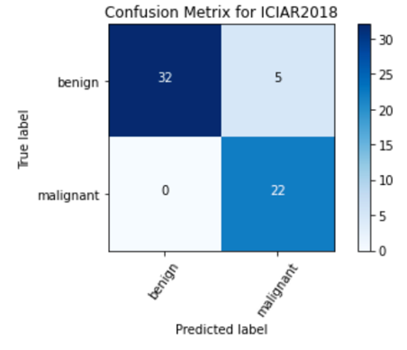
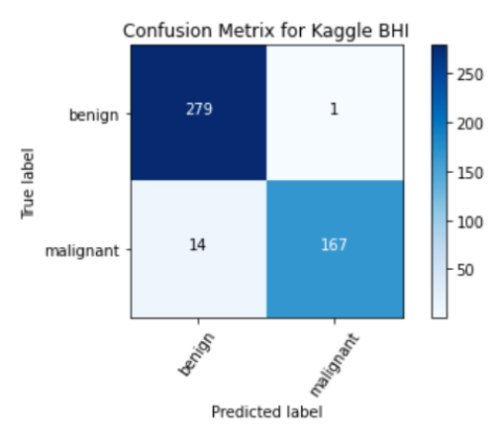
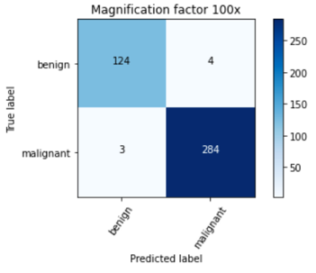
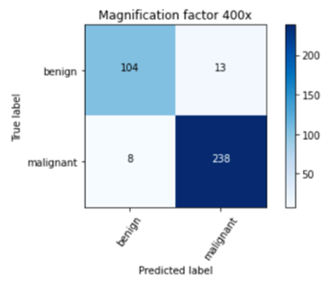
RESULT
ICIAR2018
Kaggle BHI
Breakhis

Slide 13

COMPARISON FROM OTHER MODELS
PAPER [6] shows the accuracy of 94.71% on the breakhis dataset for the most efficient model.
PAPER [4] shows an accuracy of 93% on breakhis dataset.
PAPER [5] shows accuracies of different models as 90.0 ± 6.7%, 85.36%, 92.19% and 91.0% on breakhis dataset
PAPER [1] shows accuracy of 90%, 90%, 91%, 90% for 40x, 100x, 200x and 400x respectively on breakhis dataset.
PAPER [2] shows 89.6 ± 6.5%, 85.0 ± 4.8%, 84.0 ± 3.2%, 80.8 ± 3.1% for 40x, 100x, 200x and 400x respectively on breakhis dataset.

Slide 14
Conclusions
The used model achieved an average accuracy of 96.5% on the breakhis dataset, 91.52% on the ICIAR2018 dataset and 96.74% on Kaggle BHI dataset
The used model has performed good as comparable to the existing models.
The parallel model has proved to be more efficient in terms of the accuracy as it increased the number of trainable parameters of the final model and thus increased the complexity of the model which was required for classification of images into benign and malignant classes.

Slide 15
References
Histopathological Breast Cancer Image Classification by Deep Neural Network Techniques Guided by Local Clustering, 2018.
Breast cancer histopathological image classification using convolutional neural networks, 2016.
Breast cancer classification using digital biopsy histopathology images through transfer learning., 2019.
Breast Cancer Multi-classification through Deep Neural Network and Hierarchical Classification Approach, 2020.
Deep learning-based breast cancer classification through medical imaging modalities: state of the art and research challenges, 2020.
Breast Tumor Classification Using an Ensemble Machine Learning Method, 2020.
Prediction of benign and malignant breast cancer using data mining techniques. Journal of Algorithms & Computational Technology, 2018.
Histopathological Classification of Breast Cancer Images Using a Multi-Scale Input and Multi-Feature Network, 2020
Dataset for Breast Cancer Histopathological Image Classification, 2016.
Breast Histopathology Images, 198,738 IDC(-) image patches; 78,786 IDC(+) image patches, 2018.
BACH: Grand challenge on breast cancer histology images, Medical Image Analysis, 2019.

Slide 16
Thank you

